Slide 1

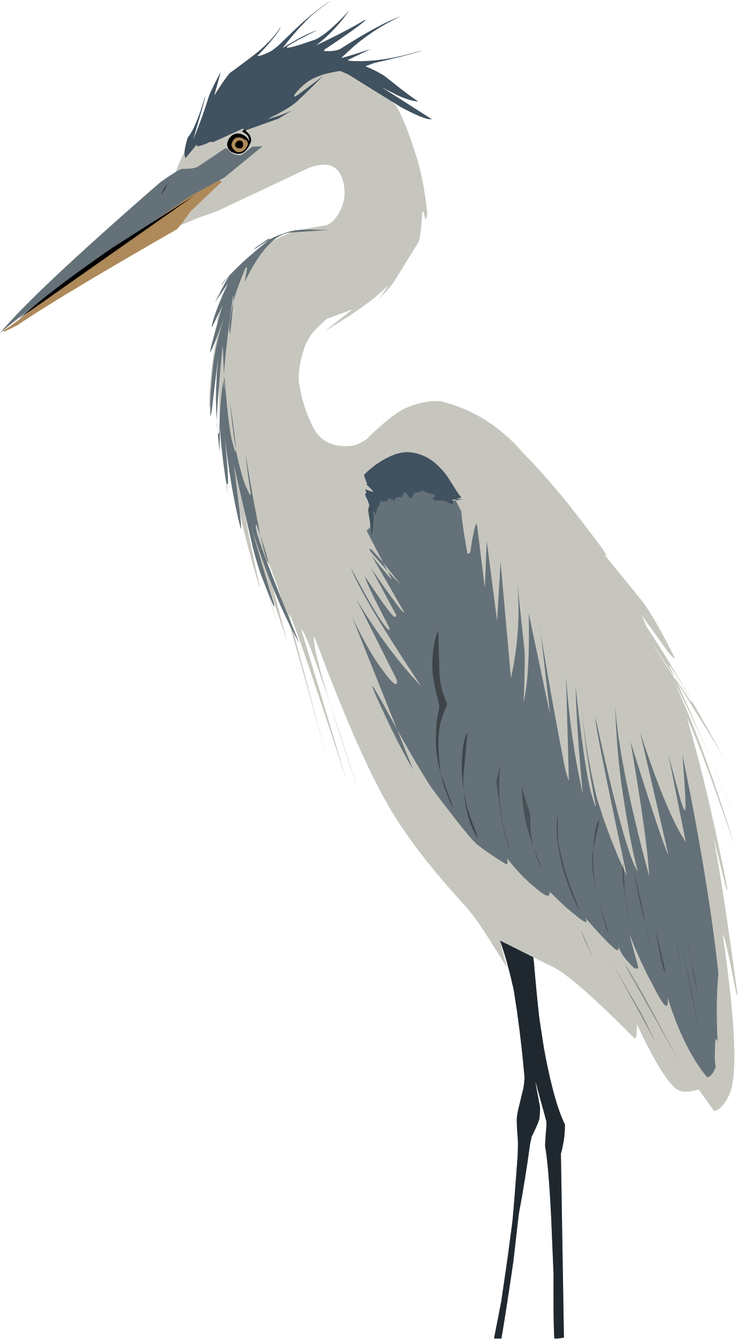

DATA 589 PROJECT
All About Blue Herom
PRESENTED BY:
ZETIAN ZHAO
LITAO ZHENG
TIANYI XIA
Notes:
"Hi, everyone. I am going to present our project about Blue Heron. We're excited to share our findings on the spatial distribution of the Blue Heron in British Columbia and its relationship with various environmental factors.

Slide 2



Topic Outline
BACKGROUND OF THE PROJECT
DATA AND RESULT FROM THE PROJECT
CONCLUSION OF THE PROJECT
Notes:
Before we dive into the details, let me give you a quick overview of what we'll be covering today. We'll start with our research goals and introduction, then move on to data preprocessing, EDA, and finally, our conclusions and future work."

Slide 3
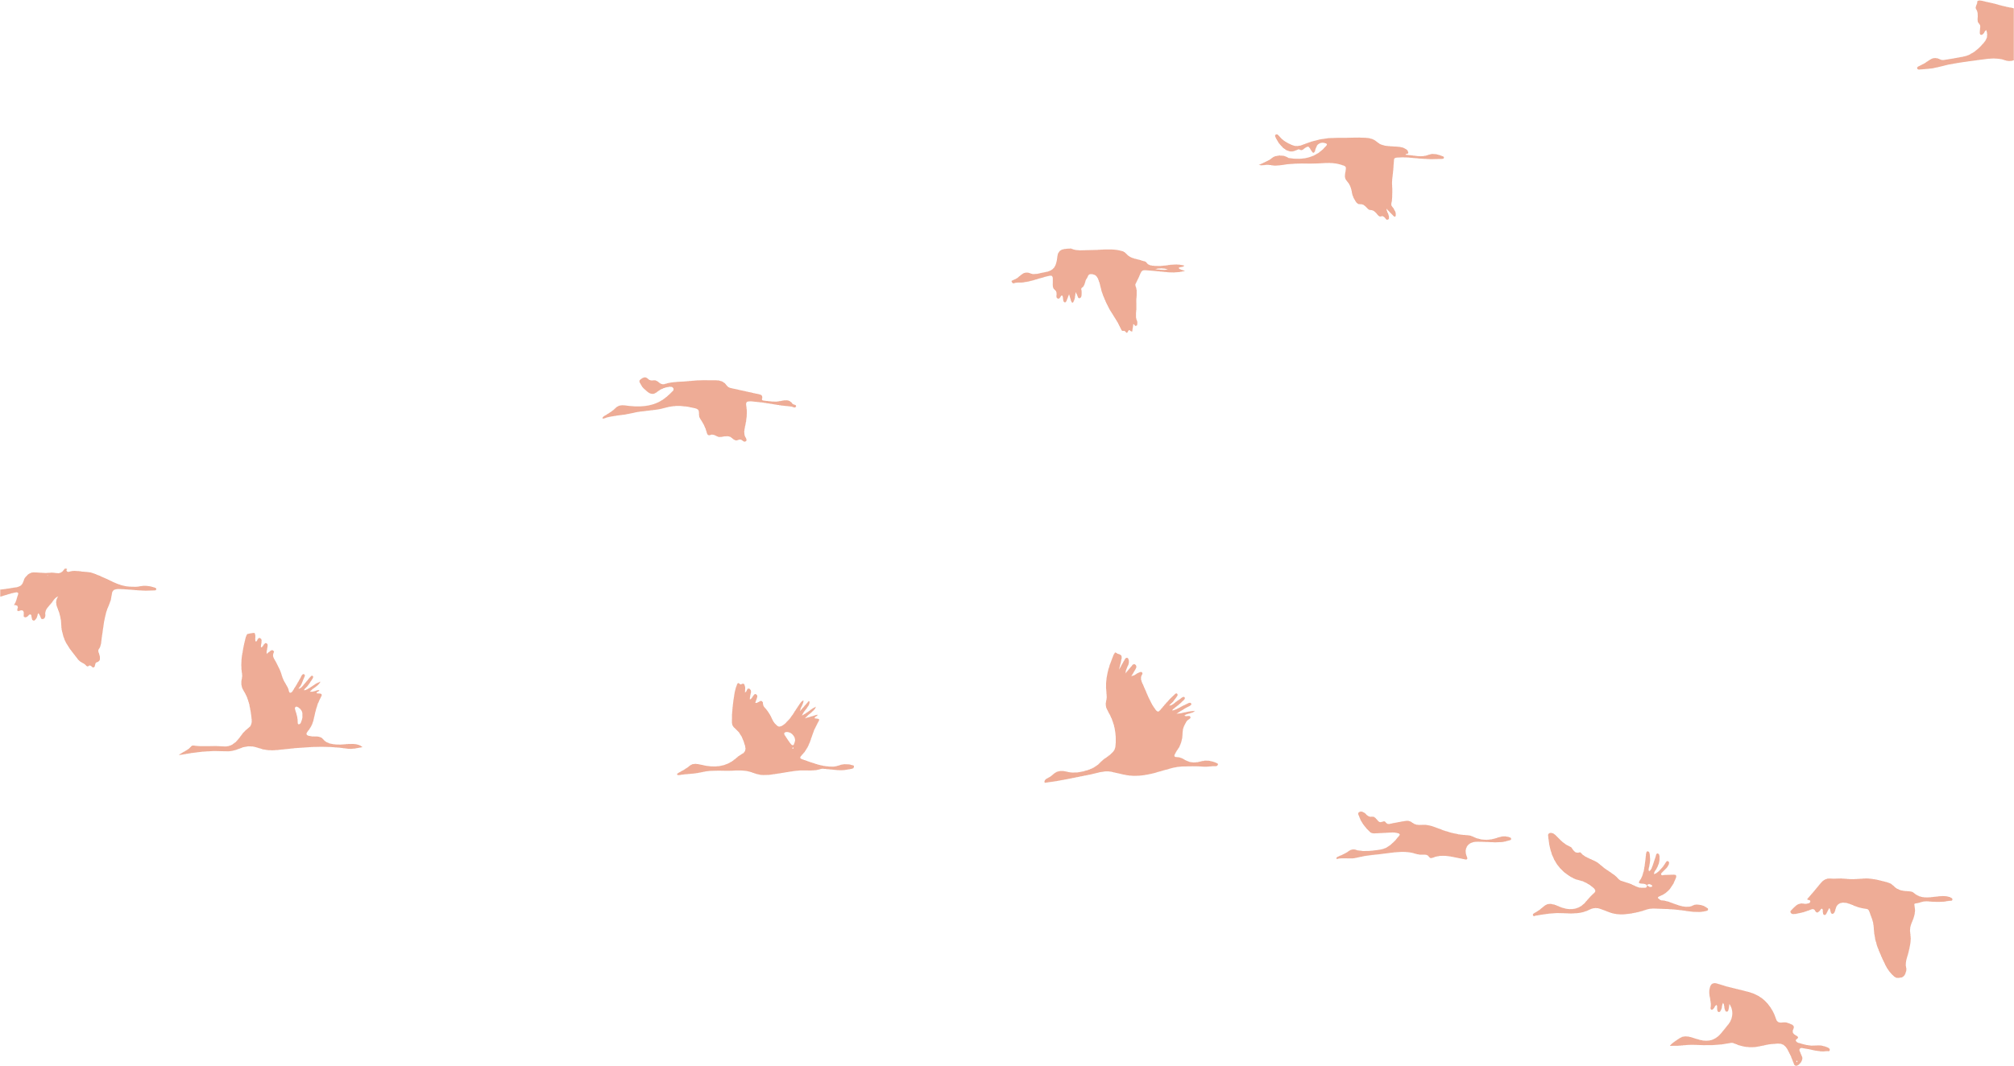

Project goal and reasearch question

Slide 4
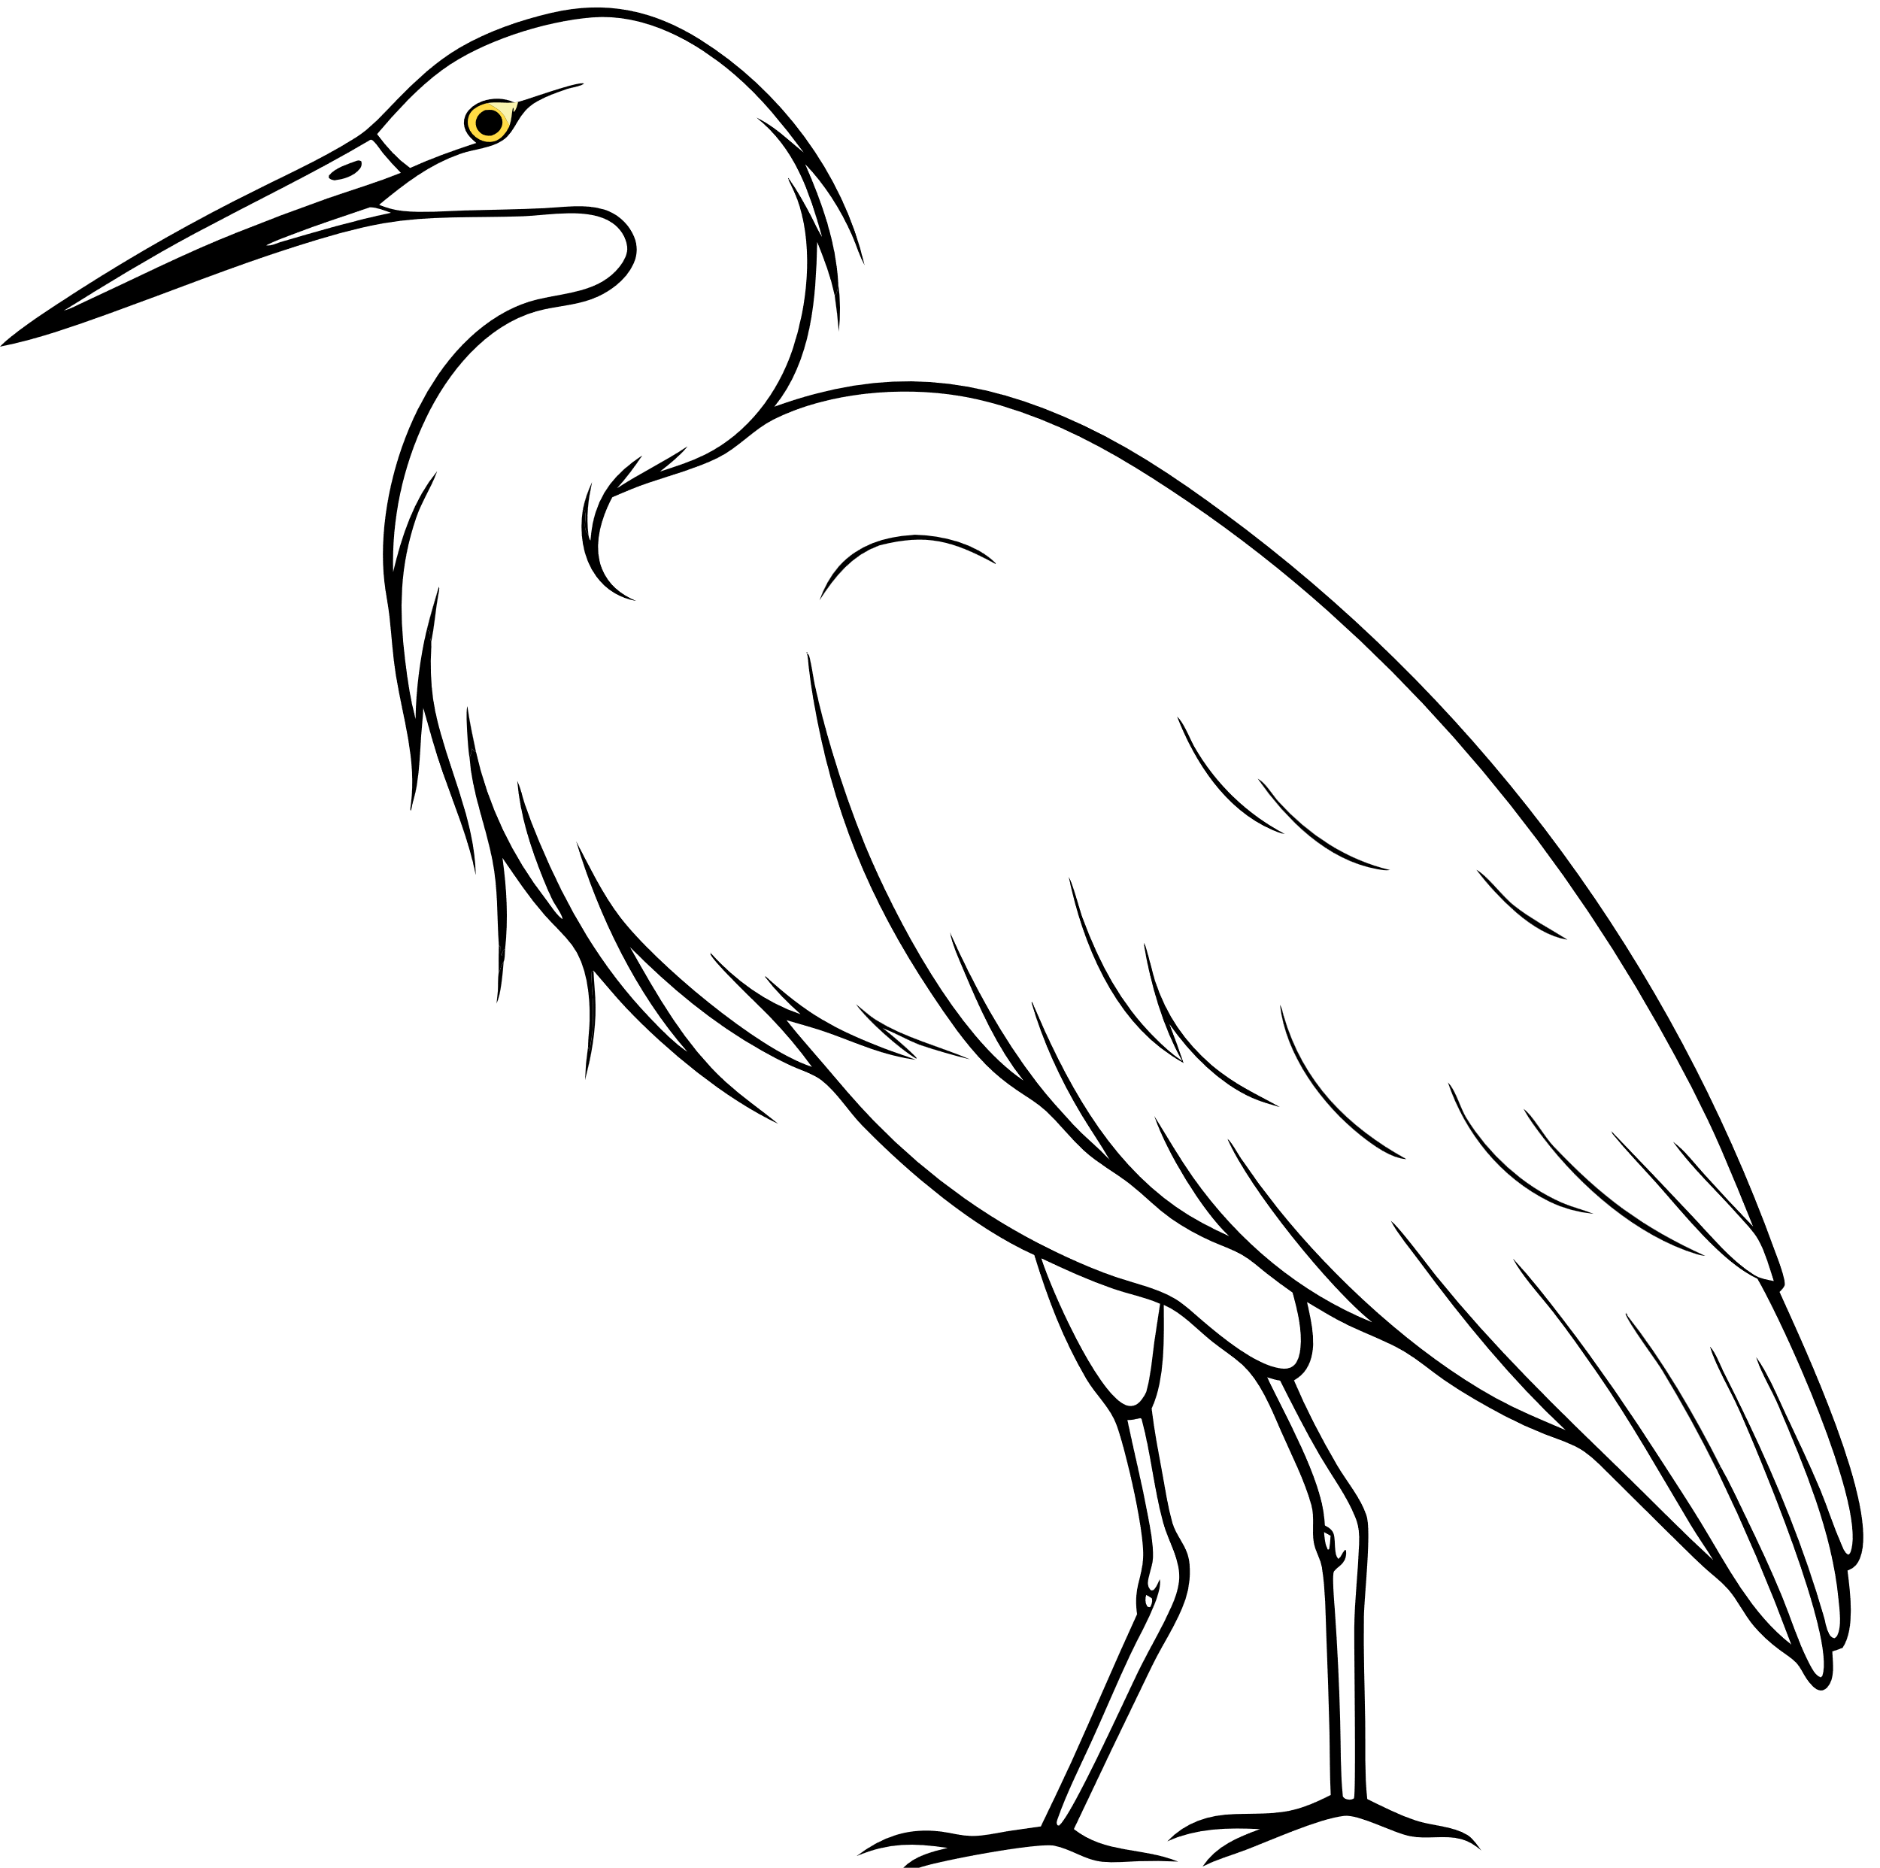
Introduction
Goal
explore spatial distribution and relationship with the environmental covariates.
Study System
The Great Blue Heron, a coastal bird, is commonly found in low-elevation wetlands and near water bodies in BC.
Research Questions
Is the distribution homogeneous or clustered?
How do elevation, forest cover, human footprint, and water proximity influence distribution?
Notes:
"Let me begin by outlining our primary goal for this project. We aimed to explore the spatial distribution of the Great Blue Heron in British Columbia and understand how various environmental covariates influence this distribution. The Great Blue Heron is a fascinating coastal bird, typically found in low-elevation wetlands and areas close to water bodies. Our research was guided by two main questions: First, is the distribution of blue heron homogeneous across the region, or do they tend to cluster in specific areas? Second, how do factors such as elevation, forest cover, human footprint, and proximity to water affect their distribution? Understanding these patterns is crucial for conservation efforts and habitat management, as it can help protect the Great Blue Heron and its habitat."

Slide 5


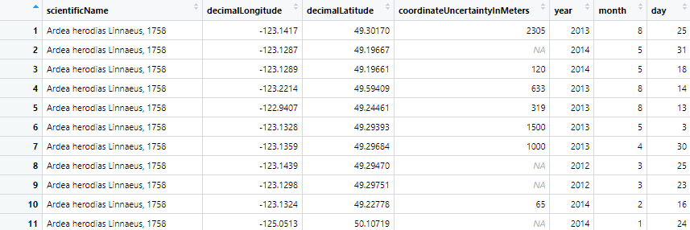
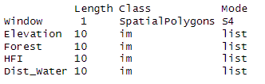
Speices data
Covariate data
DATA PREPROCESSING
ENVIRONMENTAL VARIABLES
The original CSV file contains redundant columns
Removing the missing value
Filter out the useful columns like Longitude and Latitude
Transform the coordinates to match the window
There are four external variables:
Elevation
Foreset Cover
Human Footprint index (HFI)
Distance to Water
Notes:
"Now, let's talk about the data we used and how we prepared it for analysis. We obtained our data from GBIF, which provided occurrence records of the Great Blue Heron. The original CSV file contained a lot of information, but not all of it was relevant to our study. So, our first step was to remove redundant columns and filter out the useful ones, specifically the longitude and latitude coordinates, as these are essential for spatial analysis. We also handled missing values by removing any records with missing coordinates to ensure the accuracy of our spatial analysis. Finally, we transformed the coordinates to match the spatial window of our study area, British Columbia, using R packages like 'sp' and 'rgdal' for handling spatial data and coordinate transformations."
*"In our study, we considered four key environmental variables that we hypothesized would influence the distribution of the Great Blue Heron. These are:
Elevation: Since herons are typically found in low-elevation areas, we expected this to be a significant factor.
Forest Cover: The density of forest cover might affect the availability of suitable habitats.
Human Footprint Index (HFI): This index measures human impact on the landscape, such as urban development and infrastructure, which could influence heron distribution through habitat alteration.
Distance to Water: As water birds, herons' proximity to water bodies is likely critical.
These variables were provided as raster data and integrated into our spatial analysis framework using R. The study area is defined as a SpatialPolygons object, and the covariates are represented as image objects for spatial operations."

Slide 6
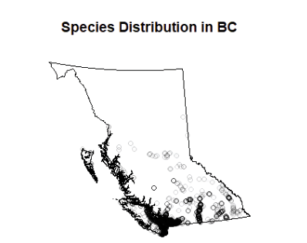

PPP Object
Observation
The majority is in the middle and south
No single point in the north
Dense points in the south border
Notes:
"Let's now look at the spatial distribution of the Great Blue Heron occurrences in British Columbia. From our data, we observed that the majority of sightings are concentrated in the middle and southern parts of the province. Interestingly, there are no recorded occurrences in the northern regions, and there is a particularly dense cluster of points along the southern border. This distribution pattern suggests that herons prefer certain areas, likely due to environmental conditions such as lower elevations, proximity to water, and possibly less forest cover. In the following slides, we'll explore how these environmental covariates correlate with the observed distribution."

Slide 7
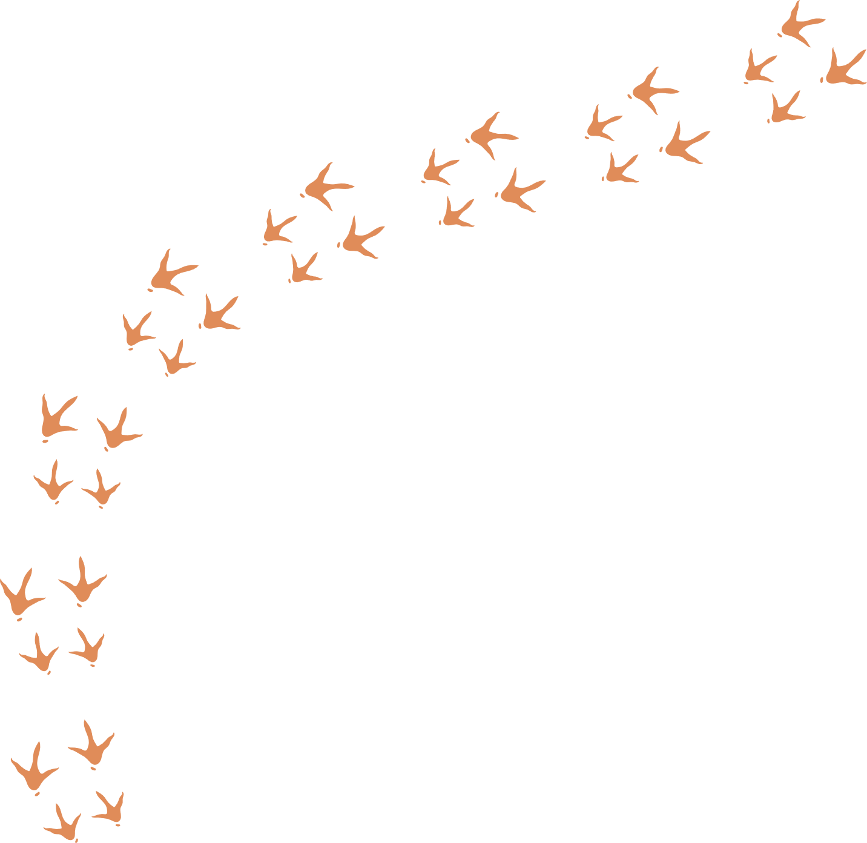

Still need more methods to verify the distribution
Notes:
Now, we have a brief idea about how the great blue heron is distributed in BC. However, we still need more methods to verify the distribution

Slide 8

Methods
TO TEST RANDOM AND HOTSPOT
First, a quadrat-test plot
Ripley’s K-function
KDE plot
Rhohat plots (covariates)
Notes:
To study the heron distribution, we used four methods. The quadrat test checks for spatial randomness, and Ripley’s K-function detects clustering across scales. KDE visualizes intensity hotspots, while rhohat plots show how factors like elevation, forest cover, and human footprint affect distribution. These methods reveal both clustering and its environmental drivers.

Slide 9

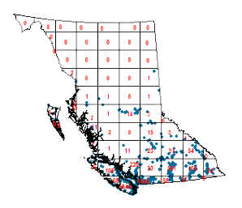
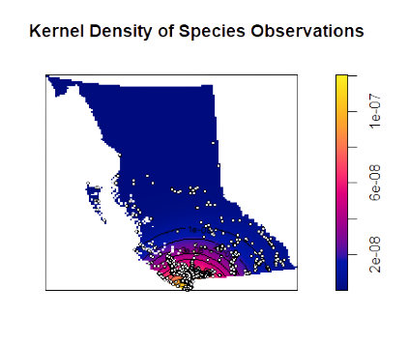
Plots result
Quadrat-Test
KDE for the entire distribution
Notes:
The quadrat test result shows a clear deviation from spatial randomness, indicating heron locations are significantly clustered. In the KDE plot, we see that the highest density is concentrated in southern BC, especially around the lower mainland and Vancouver Island. The northern part shows almost no presence. This pattern supports our assumption that the distribution is non-uniform, but it doesn’t yet explain why. That’s where we need covariate analysis to dig deeper into environmental factors driving this clustering.

Slide 10
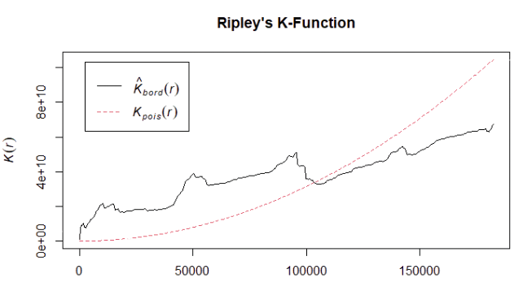
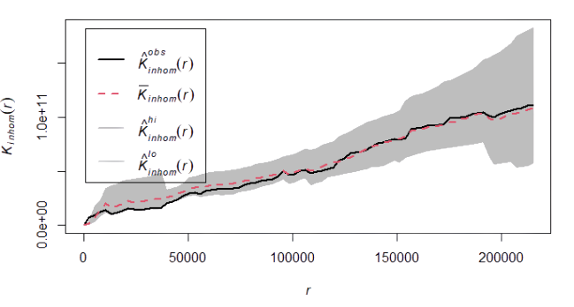
Ripley’s k-function
Standard version
Inhomogeneous version
Notes:
This slide shows Ripley’s K-function, which analyzes clustering across spatial scales. In the standard version on the left, the observed K-curve lies well above the theoretical line, especially at short distances. This means heron sightings are strongly clustered—closer together than expected under spatial randomness.
The inhomogeneous version on the right accounts for environmental covariates like elevation and forest cover. Here, the observed curve aligns more closely with the theoretical one, suggesting that much of the clustering seen earlier can be explained by those covariates. So the apparent clustering isn’t entirely random—it’s partly driven by the landscape, confirming what we saw in the quadrat test and intensity plots.

Slide 11
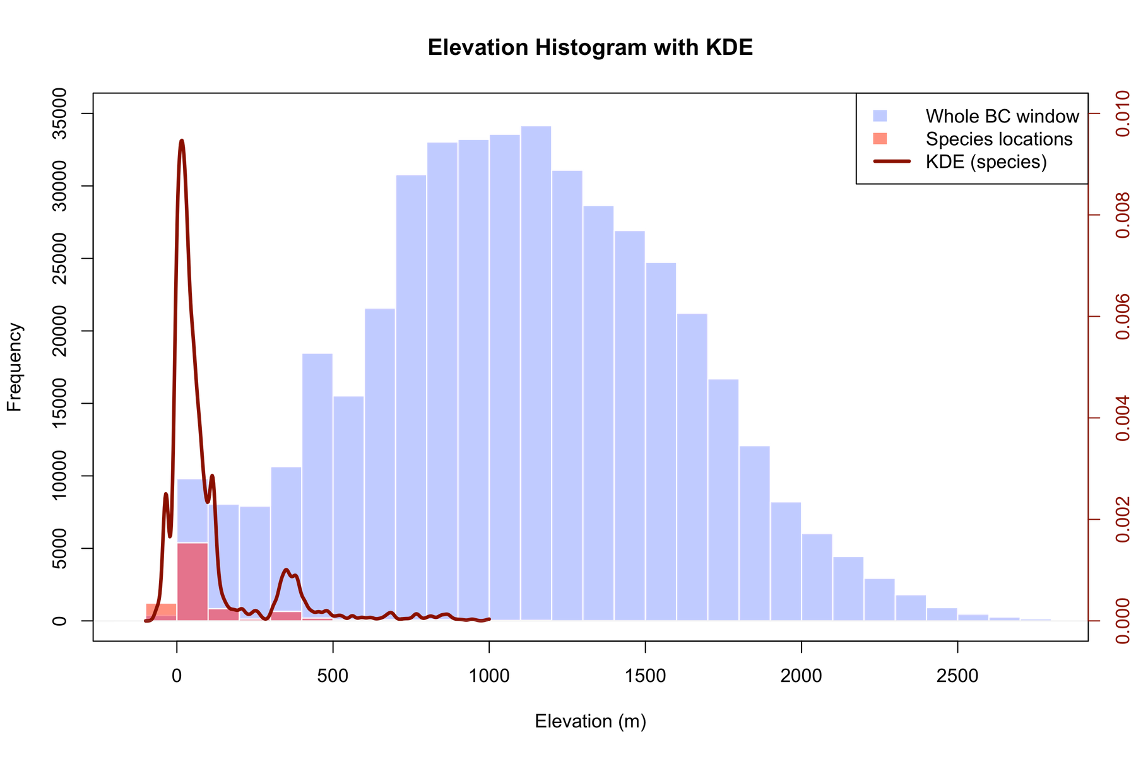
Elevation Analysis
Key Statistics
Median elevation: 38.8 m
Quadrat count: 8848
points in the lowest
quantile
Key Observations
The distribution is highly
clustered in low altitudes
Notes:
This slide focuses on elevation as a key covariate. We found that the median elevation for heron observations is just 38.8 meters, and notably, over eight thousand points fall in the lowest elevation quantile. This confirms a strong preference for low-altitude environments, consistent with the species’ reliance on wetlands and coastal zones. Visually, this is reflected in the rhohat curve, which shows intensity peaking below 500 meters. So, elevation clearly plays a central role in shaping heron distribution.

Slide 12
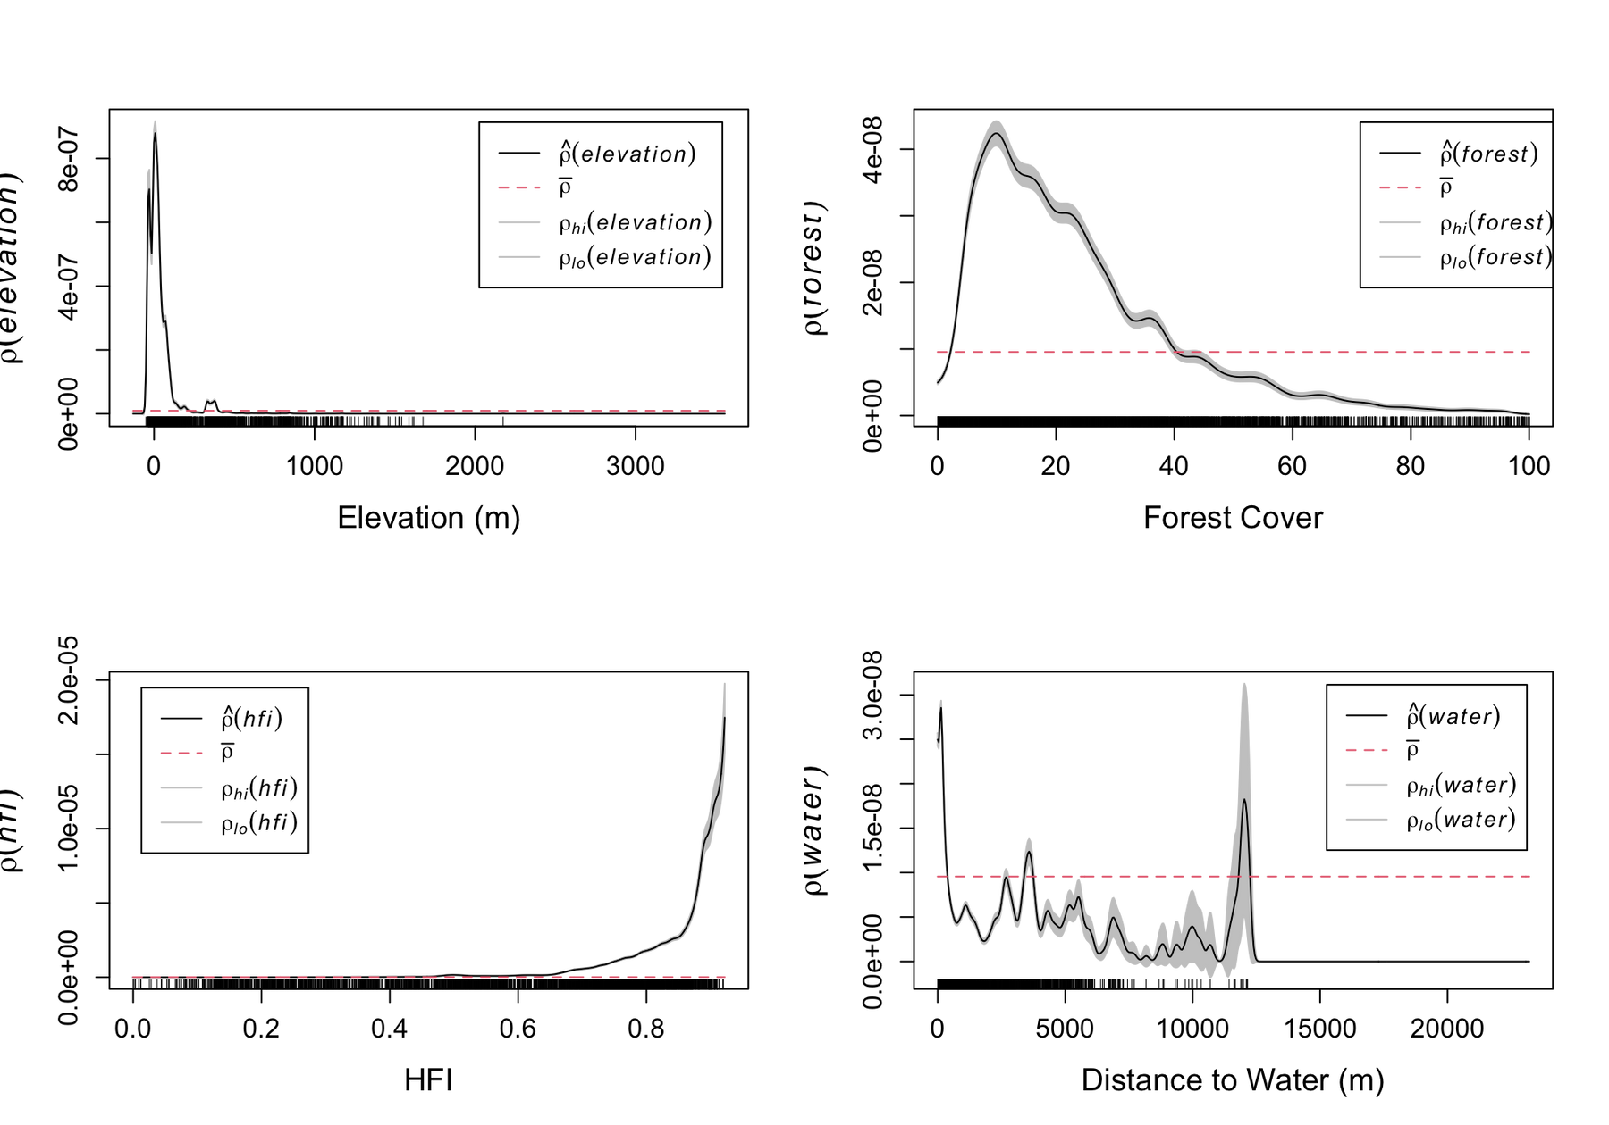


Plots for Covariate Effects (rho_hat)
Notes:
Since we have see that the elevation somehow effect the species distribution, lets explore other env covriates.
Here, we have four covariates. Elevation, forset cover, HFI, and distance from water.
From there, we can see that all of the plots show a non-uniform line pattern, indicating that all of them have the impact on the distribution of the blue heron.

Slide 13
Covariate Effects (rho_hat)
Elevation: Higher intensity in low-elevation areas (<500 m).
Forest Cover: Preference for low forest cover areas.
Human Footprint Index: Surprisingly higher intensity in areas with moderate human impact.
Distance to Water: Peak intensity at moderate distances (~1-5 km).
Notes:
So lets get some key insights from the plots in the previous slides.
So for the elevation, as we discussed before, blue heron tend to live in the low-elevation area.
For the forest cover, it is right-skewed plot, similar to the elevation plot but less dramatic. Therefore, species more intend to live in a low-meidan forest cover area.
For the human impact metric, it is surprisedly left-skewed, so blue heron like more morden environment apparently.
For the water related plot, there is a distinct fluctuation, but peaks are more focus on the low or median distance.

Slide 14
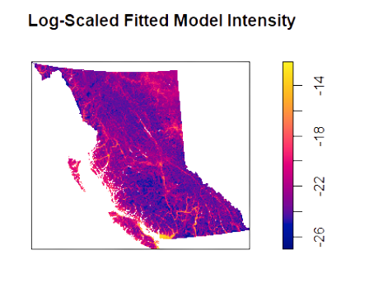

Poisson point model
Model info
The correlation between the covariates is small
AIC of our model - 269901.1
AIC of null model - 352915.5
The p-value is < 2.2e-16
Notes:
We also make a simple Poisson point process model to predict the distribution of the blue heron based on the covariate we have.
By using the certain function, the correlation between the covariates are small, so it is fine for us about using all the covariates for building our model.
Then, we use the AIC function to test the performance by comparing with a null model. And we got a much smaller AIC value and small p-value from the anova function.
therefore, it indicate our model show a significant improvement right there.
The right, is our predicted intensity plot for our species distribution.

Slide 15
Key findings
Inhomogeneous distribution, clustered in Southern BC
Low-elevation, low-forest, and near water
Randomness at some scales, but can be explained by covariates
Implications
Coastal wetlands and low-lying areas are critical habitats.
Human-modified areas may provide foraging opportunities (e.g., near fisheries).
Vaccine No. 2
Limitations and future work
GBIF data may have sampling biases (e.g., more records near urban areas).
Rhohat assumes smooth covariate relationships, potentially missing complex interactions.
Incorporate temporal trends or additional covariates (e.g., prey availability).
Notes:
OVERALL
Blue heron are inhomo in the BC provence and mainly in south part.
However, the cluster pattern is not being proved since the reply-k function.
conclusion for the covariate plot:
some place with A low-elevation, lightly forested, semi-urban wetland area — like the edge of a suburban park with a pond will be a great habitat for the blue heron
However, the dataset still have some problem since it is human-observation records.
Moreover, Rhohat assume a smooth relationship, could somehow cause biased result as well.
Therefore, we need more time to work on if we got chance and may also work with other covariates to see additional info.

Slide 16
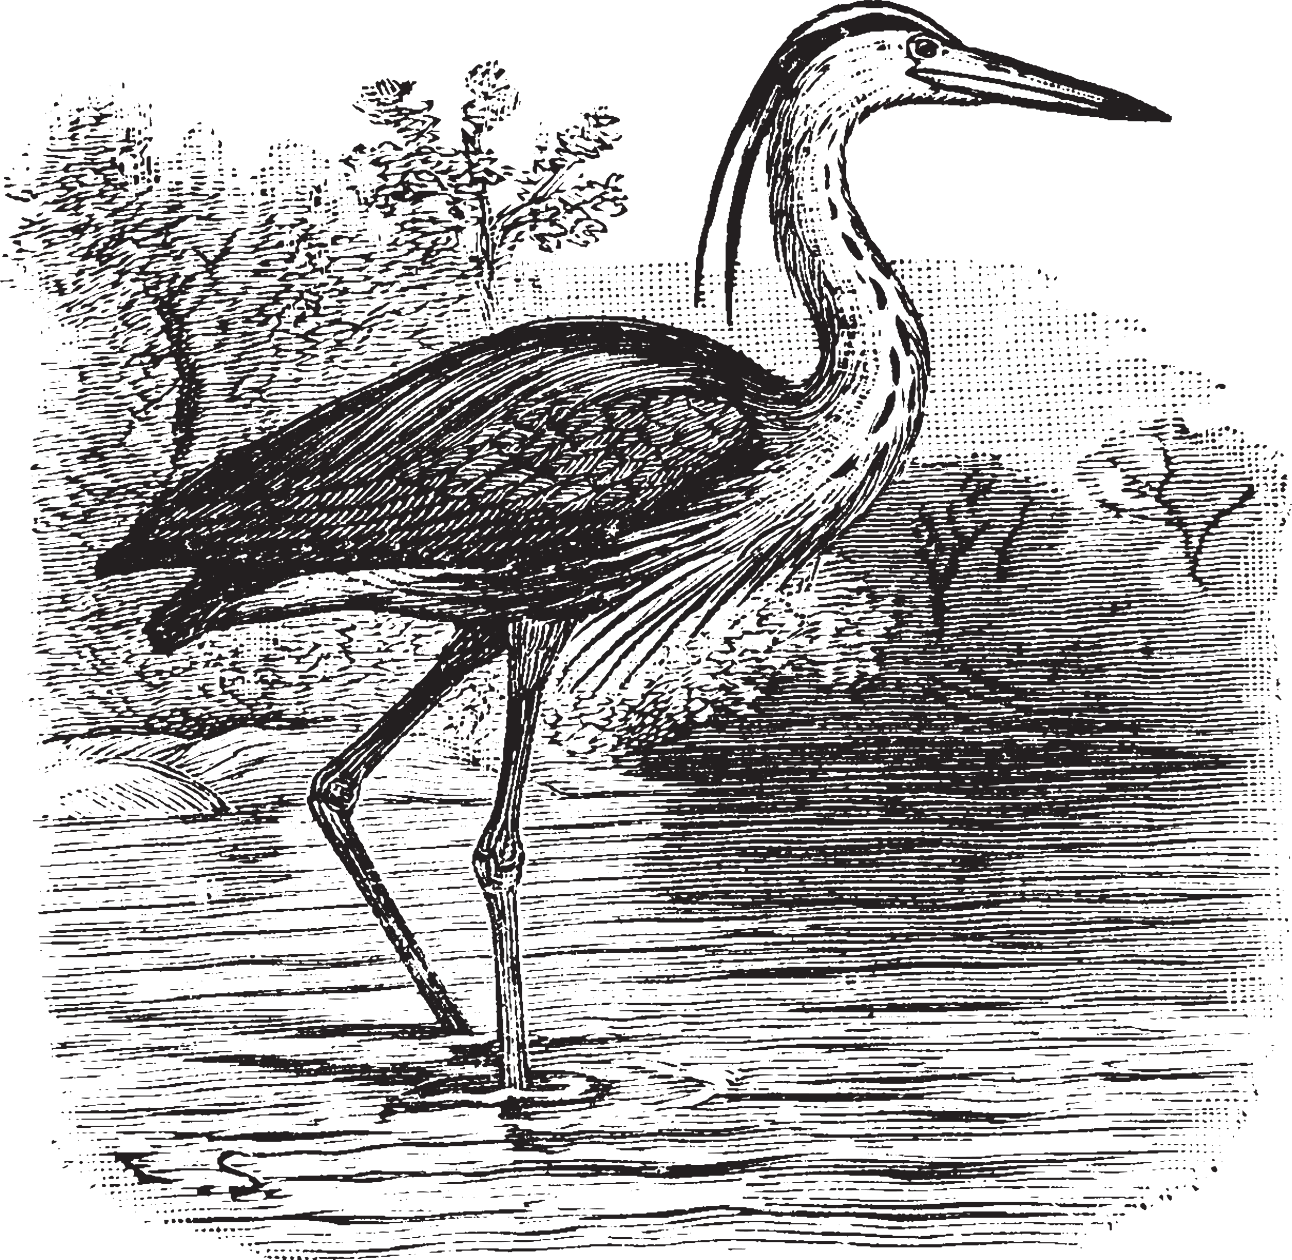
Reference
GBIF.org (2025, April 20). GBIF Occurrence Download [Dataset]. https://www.gbif.org/occurrence/download/0016124-250402121839773
Notes:
“This is our primary data source: GBIF.org, downloaded on April 20, 2025.”

Slide 17

Thank you for listening!
DON'T HESITATE TO ASK ANY QUESTIONS!

